Slide 1
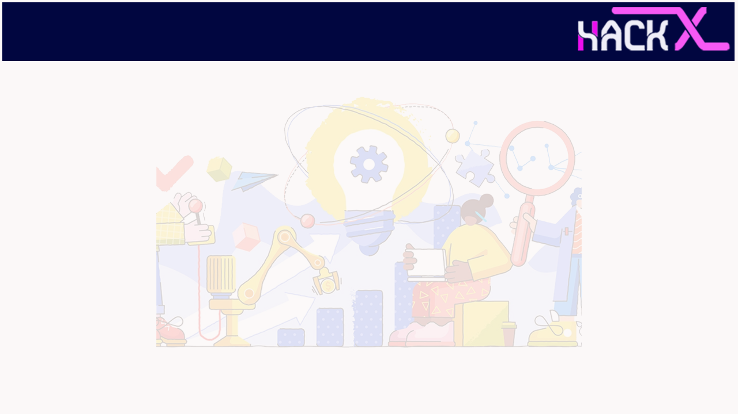
SLIDE 1
Agri-AID
Team Name: REVENGERS
Presented By: Balaji K(Leader)
Mobile No:9150662434
Domain:Open Innovation
Institute : Sri Sairam Engineering
College.
Year : Third

Slide 2

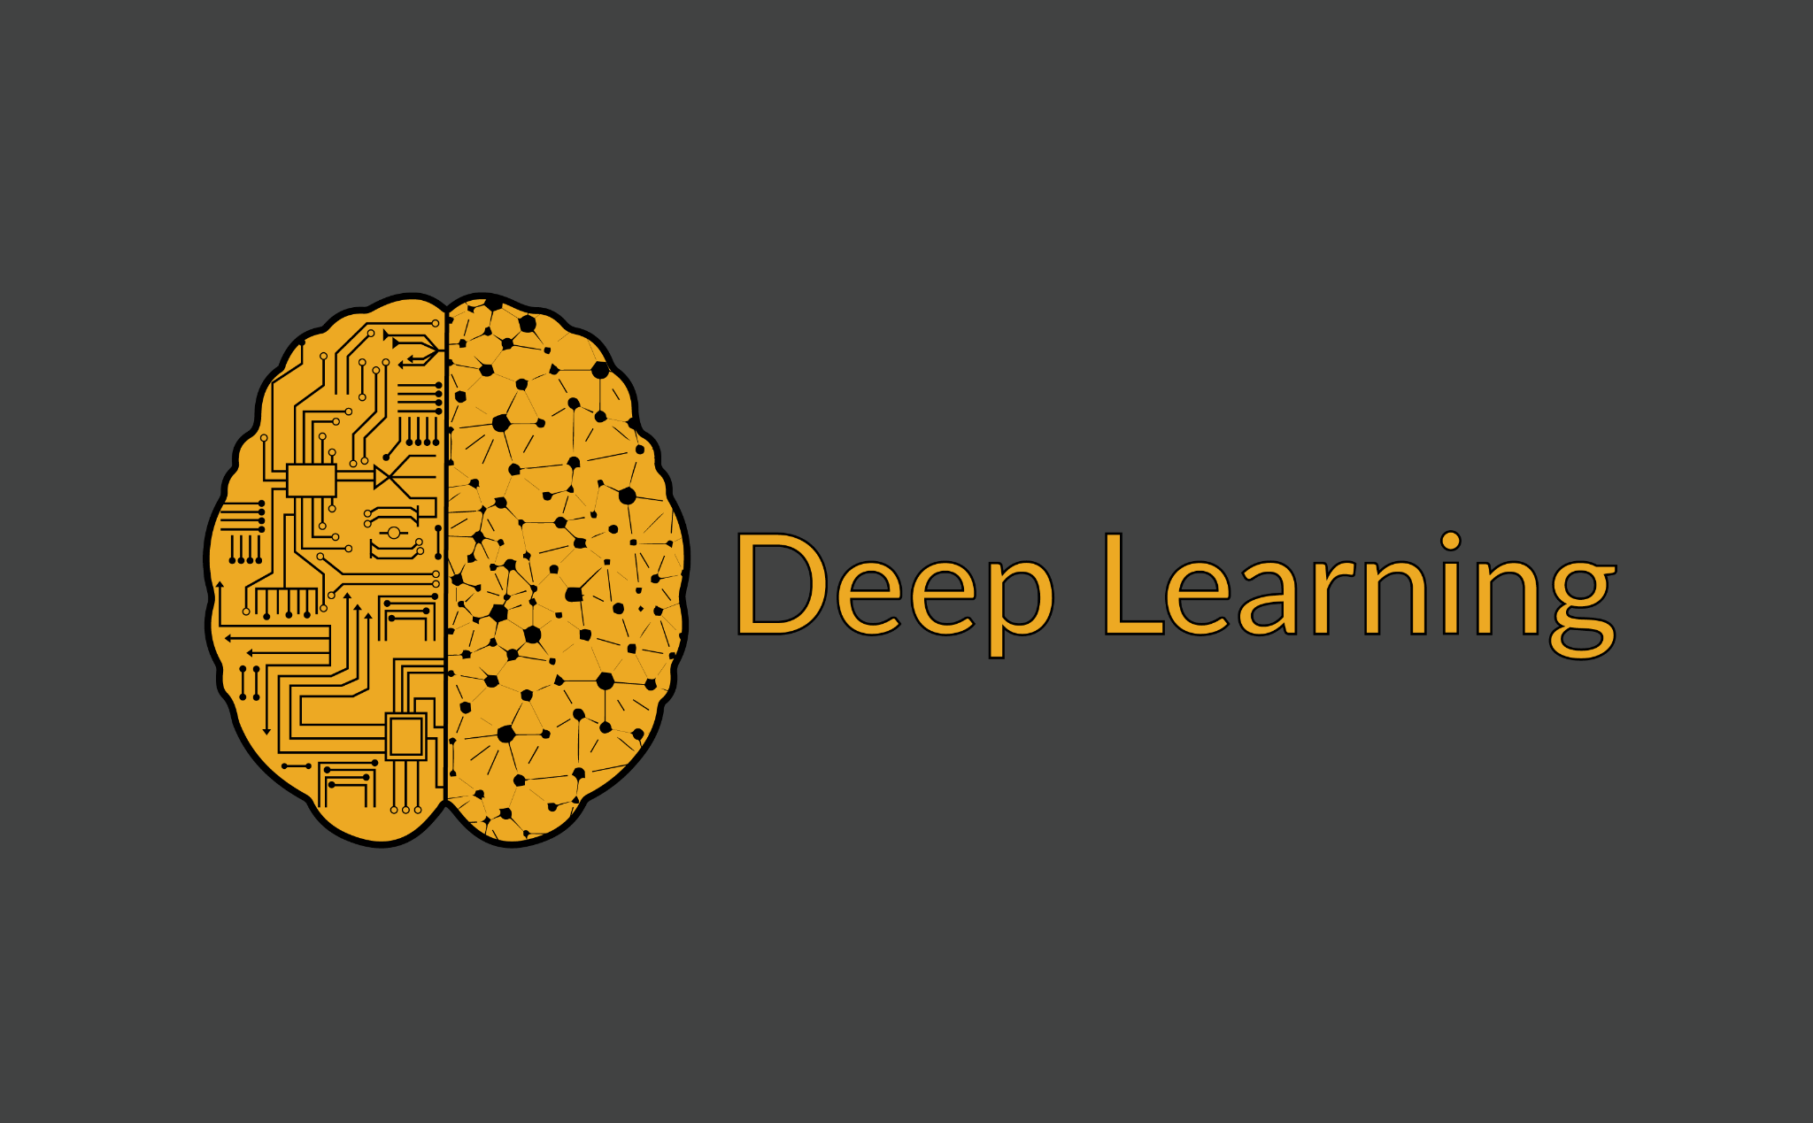
SLIDE 2
About Project
Project Title : Agri-Aid
Farming is one of the major sectors that influences a country’s economic growth.
In a country like India, the majority of the population is dependent on agriculture for their livelihood.
In this project Agri-Aid, I have designed and developed an end to end web application for Agricultural use cases.
I have created a simple machine learning based website which recommends best crop to grow, fertilizers to use and the diseases caught by your crops.

Slide 3





SLIDE 3
Tools and Technologies used in this project:
Technologies:
Data Science
Machine Learning
Deep Learning
Tools:
Programming Language : Python
Jupyter notebook : Data Preprocessing and Model Creation
Pycharm : Website Creation
Flask framework : Web App Development
HTML, CSS, Javascript : Front End Development
Heroku Cloud : Deployment

Slide 4
SLIDE 4
Stages Of My Project
Data Collection
Data
Preprocessing
Model Creation
Deployment
Web App Development

Slide 5
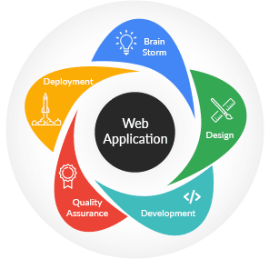

SLIDE 5
Deployment of Web Application
After the web application was developed, I deployed a web application on heroku cloud server.
Link to my project :https://agri-aid.herokuapp.com/

Slide 6
SLIDE 6
Applications of Agri-Aid
This project Agri-Aid has the following applications :
In the crop recommendation application, the user can provide the soil data from their side and the application will predict which crop
the user should grow.
For the fertilizer recommendation application, the user can input the soil data and the type of crop they are growing, and the application will predict what the soil lacks or has excess of and will recommend improvements.

Slide 7
SLIDE 7
For the plant disease prediction application, the user can input an image of a diseased plant leaf, and the application will predict what disease it is and will also give a little information about the disease and suggestions to cure it.
Further Improvements
More data can be collected in large scale to make the system more accurate.
Advanced Regression and Feature Engineering Techniques can be employed in production estimation application to increase the accuracy of the system.
Additional plant images can be collected to make the disease detection part more robust and generalized.

Slide 8
SLIDE 8
THANK YOU

